Slide 1

Amendment to the Ordinance Regulating the Siting of Wind Energy Conversion Systems
Christian County, IL
Zoning Board of Appeals
June 23rd 2020

Slide 2

Applicants
    City of Roses Wind Energy LLC
    235 MW Project
    Located in southeast Christian County
    $300M estimated cost
    $50M estimated taxes paid over project life

Slide 3

Applicants
    Rolling Farms Wind Project LLC
    200 MW Project
    Located in southeast Christian County
    $250M estimated cost
    $45M estimated taxes paid over project life

Slide 4
Summary of Text Amendments
    Section V:
    - Require WECS Project applicants to enter into the AIMA with Illinois Department of Agriculture
    Section VI:
    - Require that final turbine locations comply with applicable FAA regulations
    - Increase the Primary Structure setback from 1,000 feet to 1,500 feet
    - Increase maximum turbine height from 450 feet to 660 feet, which will allow wind energy projects to utilize modern turbines with increased nameplate capacity and decrease the number of turbines required for a project
    - Limit wind energy projects to 30 hours of annual shadow flicker in non-participating Primary Structures
    Section XII:
    - Clarify requirements for calculating the amount of financial security for decommissioning and to require that the amount of decommissioning security be posted in accordance with the AIMA and updated every five years

Slide 5

Turbine Height
    Turbines are getting taller and more efficient as technology evolves
    Benefits of increased turbine height:
    Larger nameplate capacity – more MW per turbine
    Less turbines installed
    State of the art design
    Same tax benefits

Slide 6
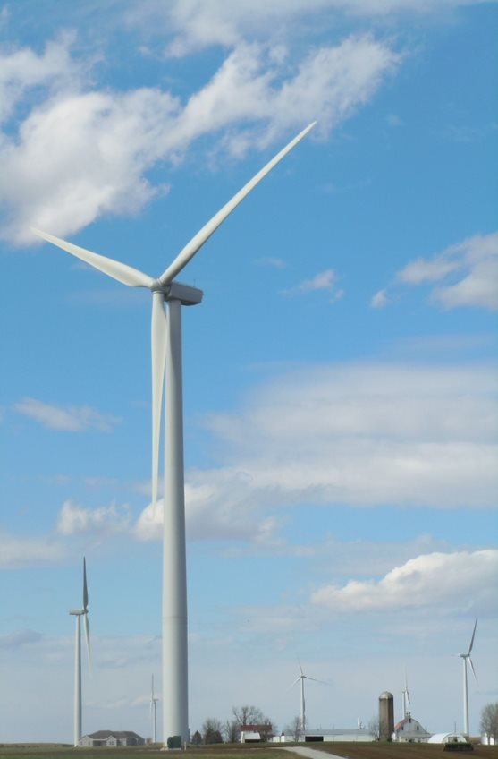
Setbacks
    Current setback from residences is 1,000ft
    Proposing a setback of 1,500ft from residences
    Exceeds setback requirement of several IL Counties with operating wind farms

Slide 7

Shadow Flicker
    Ordinance does not currently impose a limit
    Proposing a limit of 30 hours
    This is a common limit for wind farms in the US

Slide 8
Other proposed text amendments
    County Board:
    ADLS mandatory
    Emergency response plan and funding required
    City of Roses and Rolling Farms support County Board text amendments
    Zoning Administrator:
    Primary Structure setback of 1,600 feet
    Increase insurance amounts to $5M per occurrence and $30M aggregate
    Indemnity provision
    100% of Financial Assurance for Decommissioning provided at building permit
    Increased building permit fees
    PCC:
    City of Roses and Rolling Farms generally object to the PCC text amendments
    Moratorium request unnecessary and moot

Slide 9
Application Request
    Recommendation to County Board to incorporate the proposed amendments into the Ordinance Regulating the Siting of Wind Energy Conversion Systems

